Slide 1
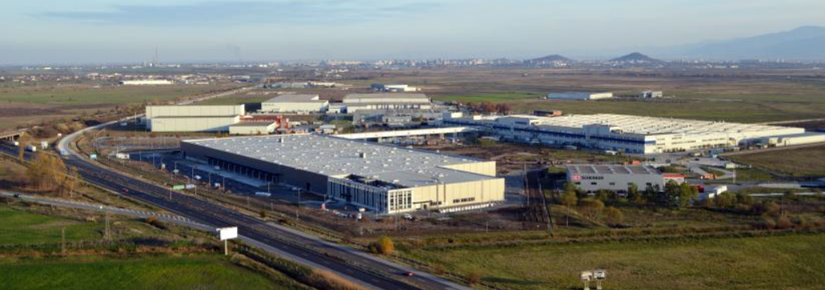
18 February 2021| 13:00 EET
EU Support for Economic Recovery, Cohesion and Reforms in Bulgaria
While committing on the green and digital transformations, the EU had to face the severe shock of the COVID19 pandemic. It inevitably changed the focus of the long term commitment, combining the economic recovery with increasing its resilience and pursuing the goals of the Green Deal and the digital transformation. The EU will provide guidance, coordination and an unprecedented budget of 1.8 trillion euro over the next few years.
What are the reforms needed and how they will be implemented at the regional and municipal levels – closer to the citizens? Will they mitigate the regional disparities, increased as a result of COVID19? By the end of April the national plans have to be up and running. Programming longer-term cohesion investment cannot be delayed either.
EURACTIV Bulgaria invites you to discuss these issues, taking the case of Bulgaria, but setting the larger picture at an online conference with eminent speakers, covering at 360 degrees EU, national and regional viewpoints.
KEYNOTE SPEAKER
Elisa Ferreira, European Commissioner for Cohesion and Reform
PANELLISTS
Denitsa Nikolova, Deputy Minister of Regional Development;
Andrey Novakov, MEP, Member of the Committee on Regional development;
Plamen Panchev, Executive Director of Trakia Economic Zone;
Petar Ganev, Institute for Market Economy
MODERATOR
Ivailo Kalfin – former deputy Prime Minister of Bulgaria in two governments and President of the Board of EURACTIV Bulgaria
REGISTRATION
To confirm your participation, please register at:
https://us02web.zoom.us/webinar/register/WN__xl5r5ZyStqWF_EGnS_Pyw
Also live on EURACTIV Bulgaria’s Facebook page:
https://www.facebook.com/euractiv.bg
PROGRAMME
13.00: Opening by the moderator Ivailo Kalfin, former deputy Prime Minister of Bulgaria in two governments and President of the Board of EURACTIV Bulgaria; Keynote speech by Elisa Ferreira, European Commissioner for Cohesion and Reform, followed by Q&A; 13.30: Panel opens with contribution by Denitsa Nikolova, Deputy Minister of Regional Development; 13.40: Contribution by MEP Andrey Novakov, Member of the Committee on Regional development; 13.50: Contribution by Plamen Panchev, Executive Director of Trakia Economic Zone; 14.00 Contribution by Petar Ganev, Institute for Market Economy; 14:10 Q&A from the audience including the press. 14:30 Conclusion
FOR MORE INFORMATION PLEASE CONTACT GEORGI GOTEV:
gggotev@gmail.com; GSM +324 99 58 725

